Slide 1
ROBOTIC FUNDAMENTALS (UFMF4X-15-M)
Trajectories
(Cartesian Space)

Slide 2

Previously on
Joint interpolated movement is simple to implement but does not provide straight line motion.
Linear or polynomial trajectories can be calculated.
Polynomial trajectories can keep ‘jerk’ low.
Continuous path motion gives a “smoother” motion.
Questions?

Slide 3
Today’s Lecture
Trajectories with Vias
Cartesian Space

Slide 4
Outline
Via Points
Path Generation – Cartesian Space
Difficulties / Constrains
Linear Motion
Run Time Path Generation
Collision-free Path Planning

Slide 5
Via Points
Joint Space Trajectories

Slide 6
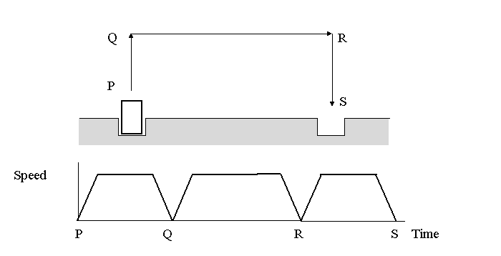
Non Continuous Path Mode

Slide 7
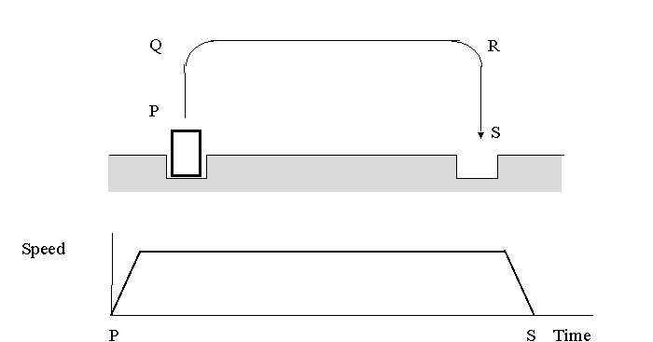
Continuous Path Mode
Notes:
The position of the robot at time t₀ is known and using the inverse kinematic equations of the robot, the joint angles at via points and at the end of the motion can be found.
To blend the motion segments together, the boundary conditions of via points are used to calculate the coefficients of the parabolic segments.

Slide 8
Path motion with via points
Why use via points:
As the order of polynomial increases, its oscillatory behaviour also increases
Numerical accuracy decreases with the increased order polynomial
Coefficients have to be recomputed if only one point on the trajectory changes
Via points described in terms of a desired position and orientation
Low order polynomials connect the via points
Velocity constraints are not zero in via points
Velocity in via points chosen in a way to maintain constant acceleration

Slide 9
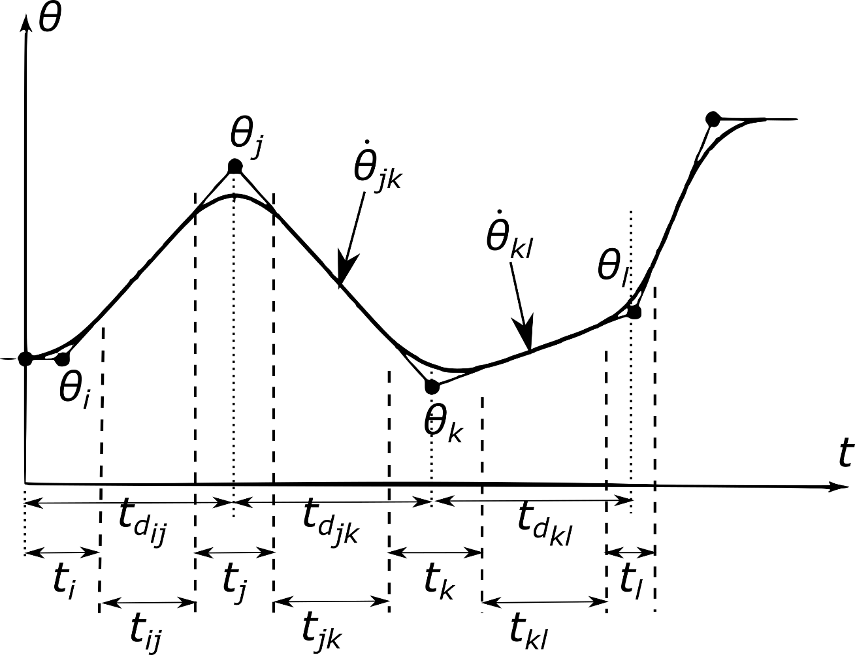
Via points – For a single joint parameter
t_{i} t_{j} t_{k} t_{l} : blend times
t_{ij} t_{jk} t_{kl} : linear times
t_{dij} t_{djk} t_{dkl} : durations

Slide 10
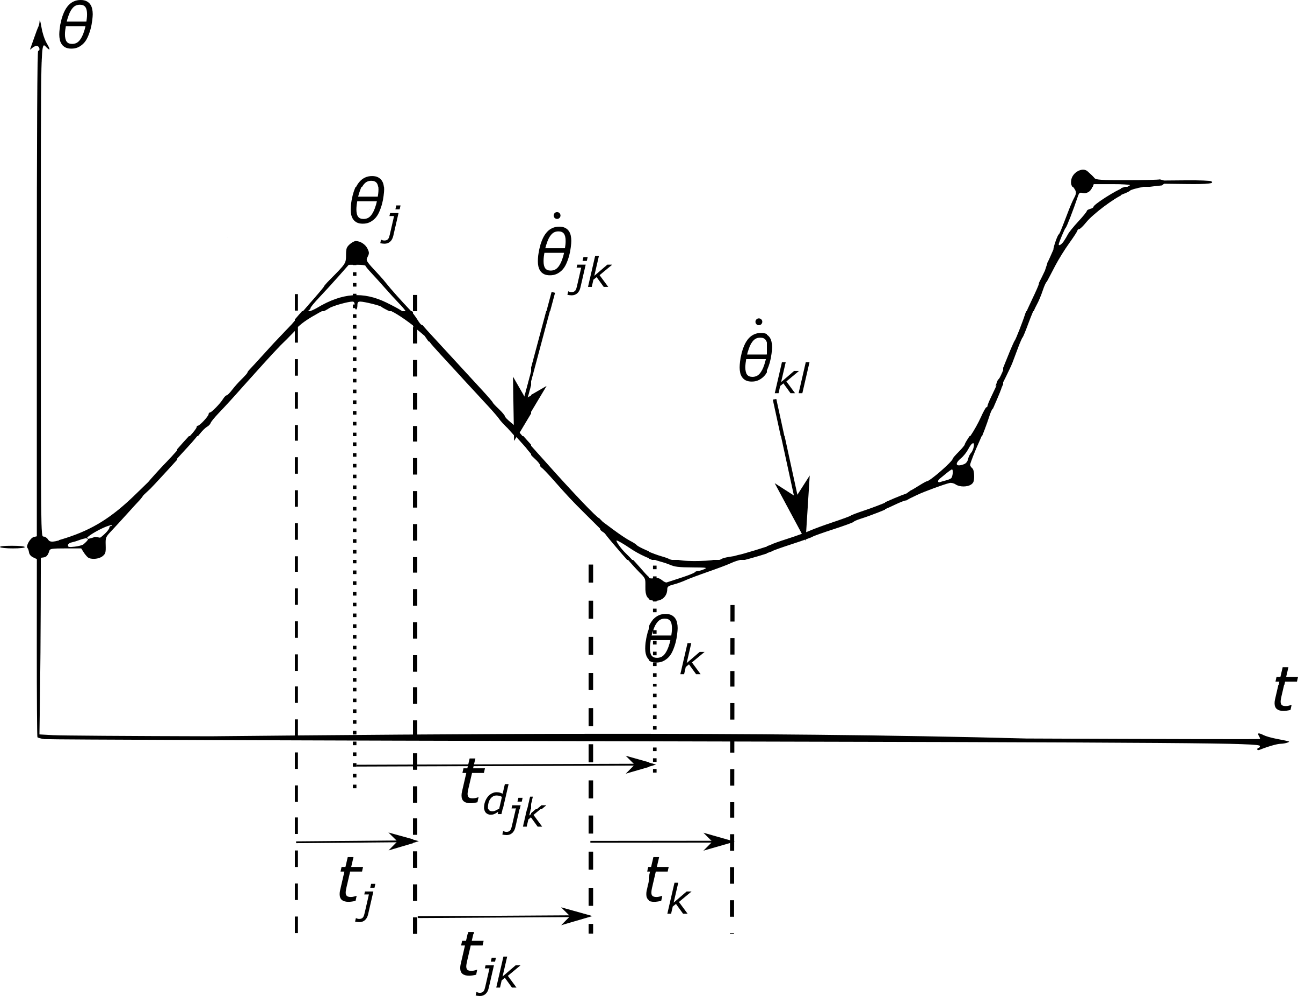
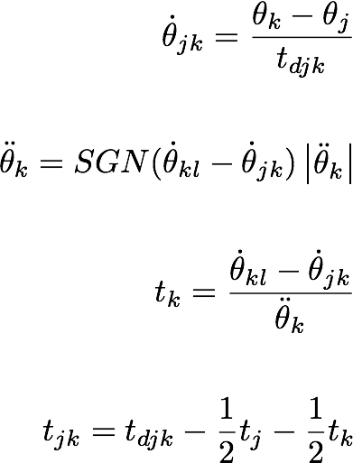
Via points – Middle Sections
θ_{l}

Slide 11
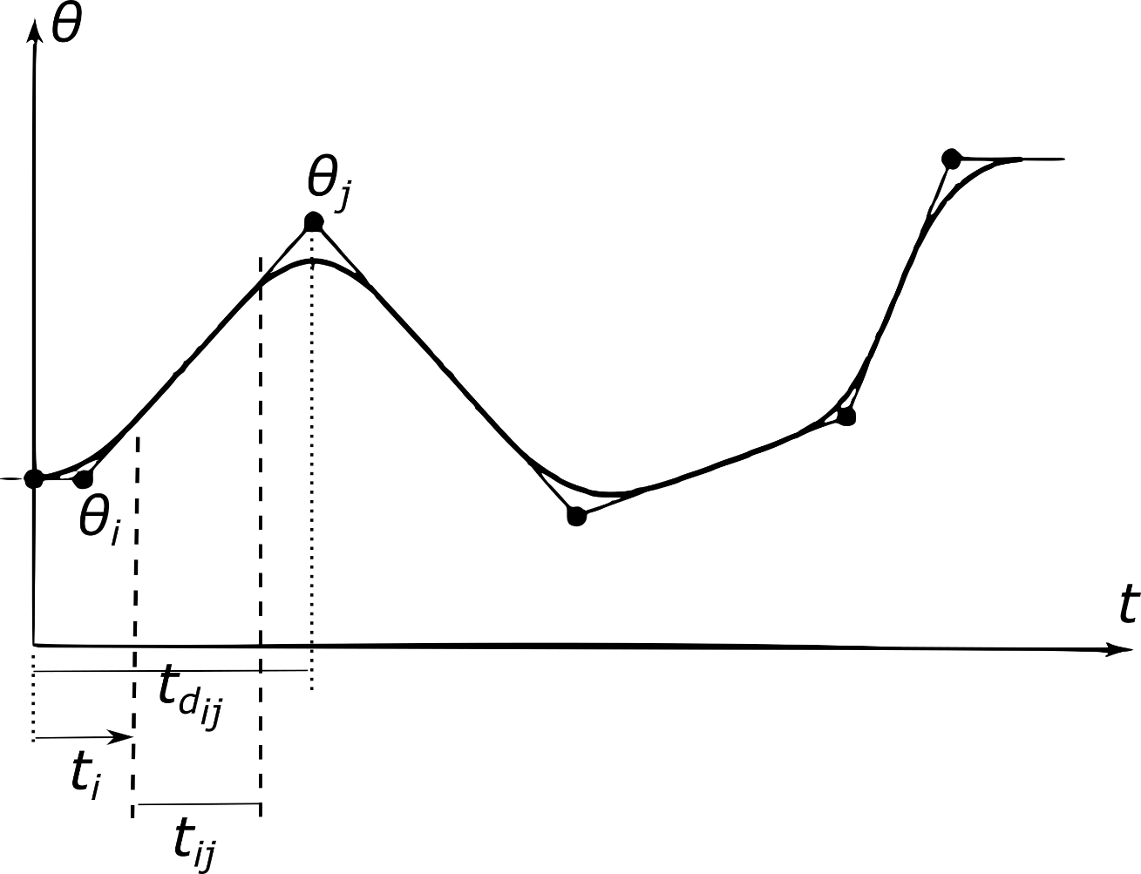
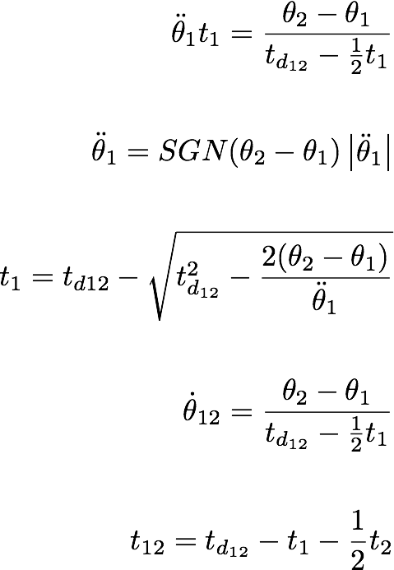
Via points – Starting Section

Slide 12
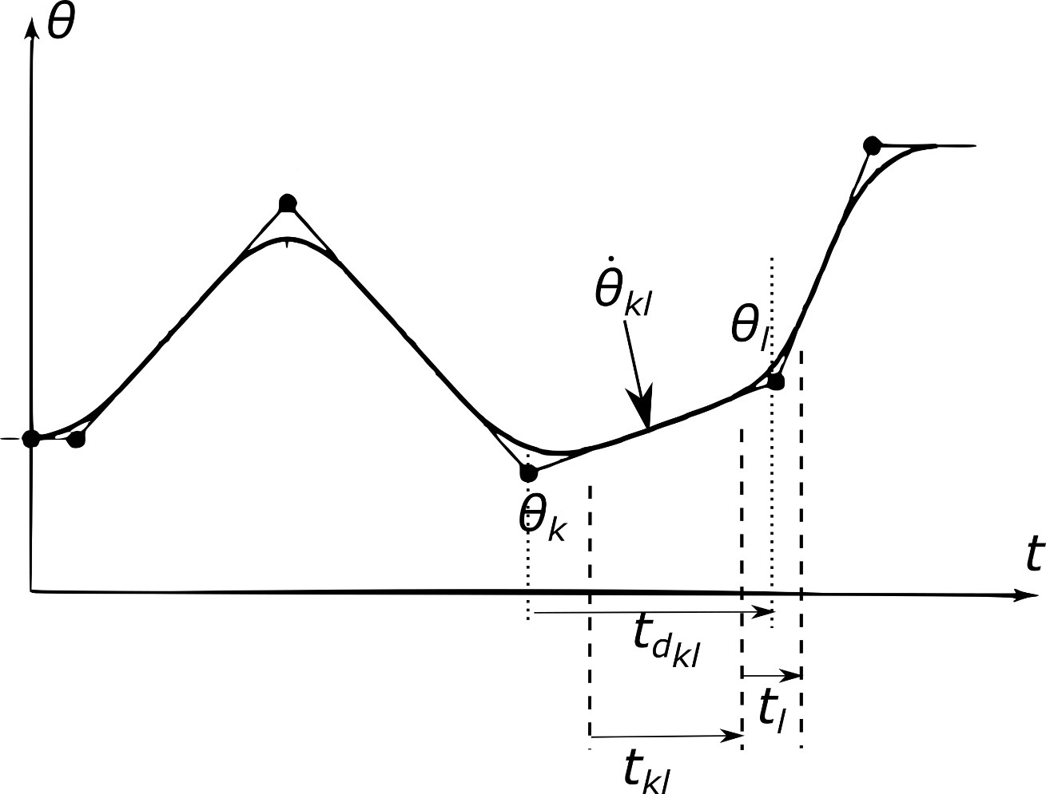
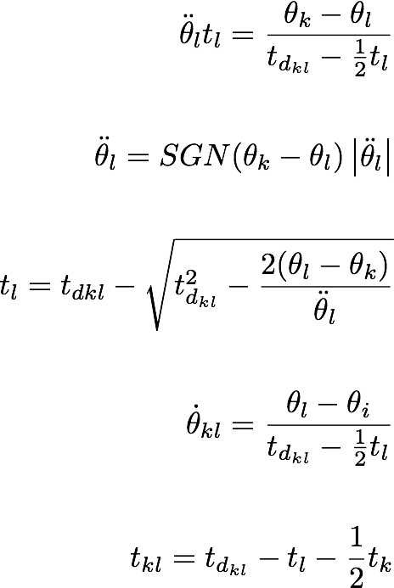
Via points – Finishing Section

Slide 13
Cartesian space trajectories

Slide 14
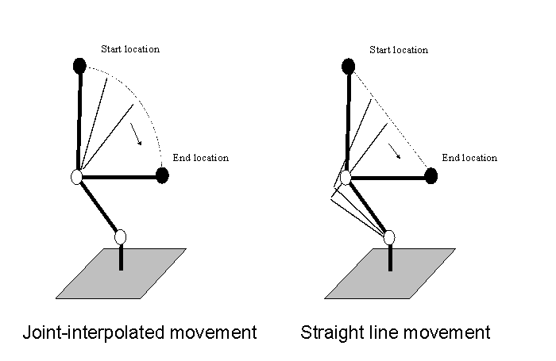
Cartesian Space Trajectories
Notes:
We use Cartesian trajectories when not only the start and end positions are important but also the way of getting from one point to the other. This is needed in constrained environments, as opposed to free ones.

Slide 15
Cartesian Space Trajectories
Straight line motion can be produced if the trajectory generation is carried out in Cartesian space:
The trajectory is applied to the linear coordinates and angles which represent the end-effector location ⁰T₆.
These trajectories are then sampled to produce a set of ⁰T₆ transformations spanning the whole movement.
Performing the inverse kinematics calculation on each one of these gives a set of joint angle vectors for the manipulator to follow.

Slide 16
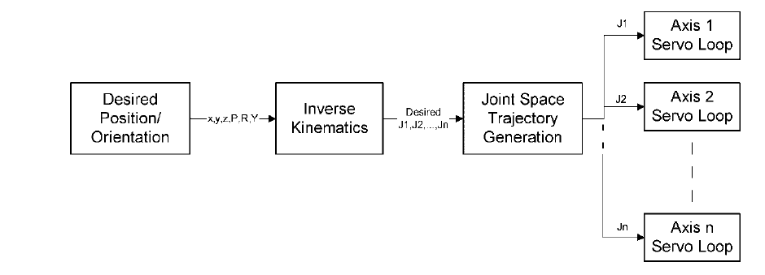
Trajectory Generation
Each end-effector position calculated using IK.

Slide 17
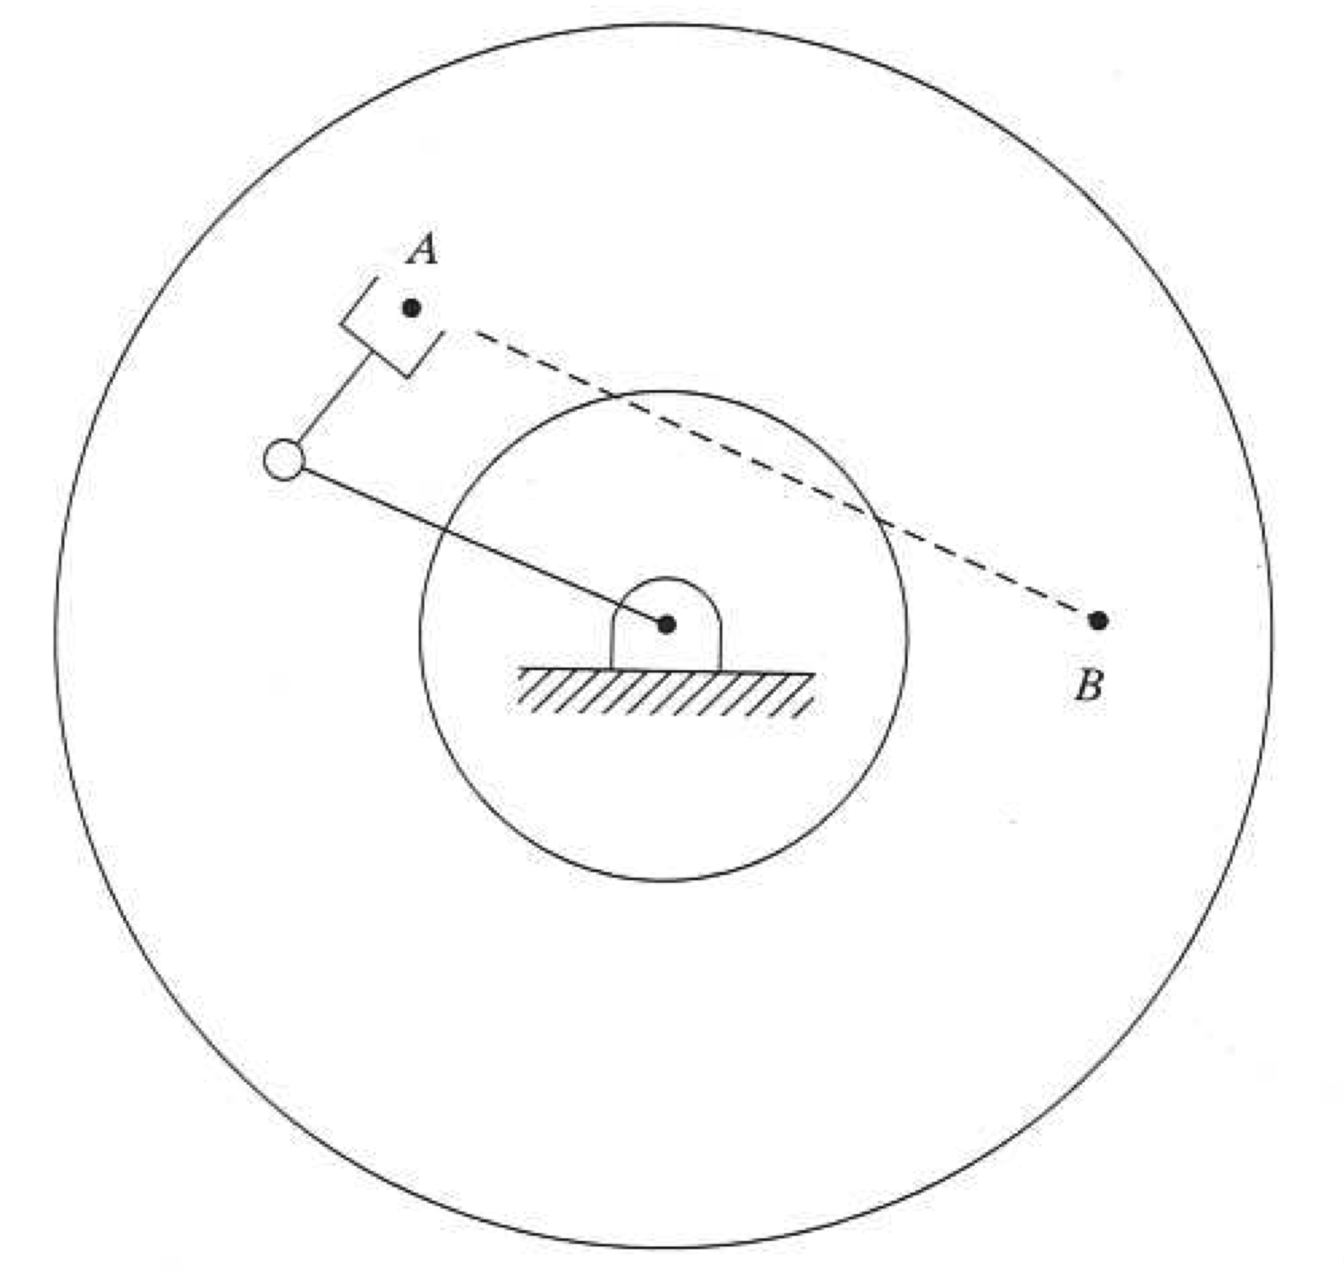
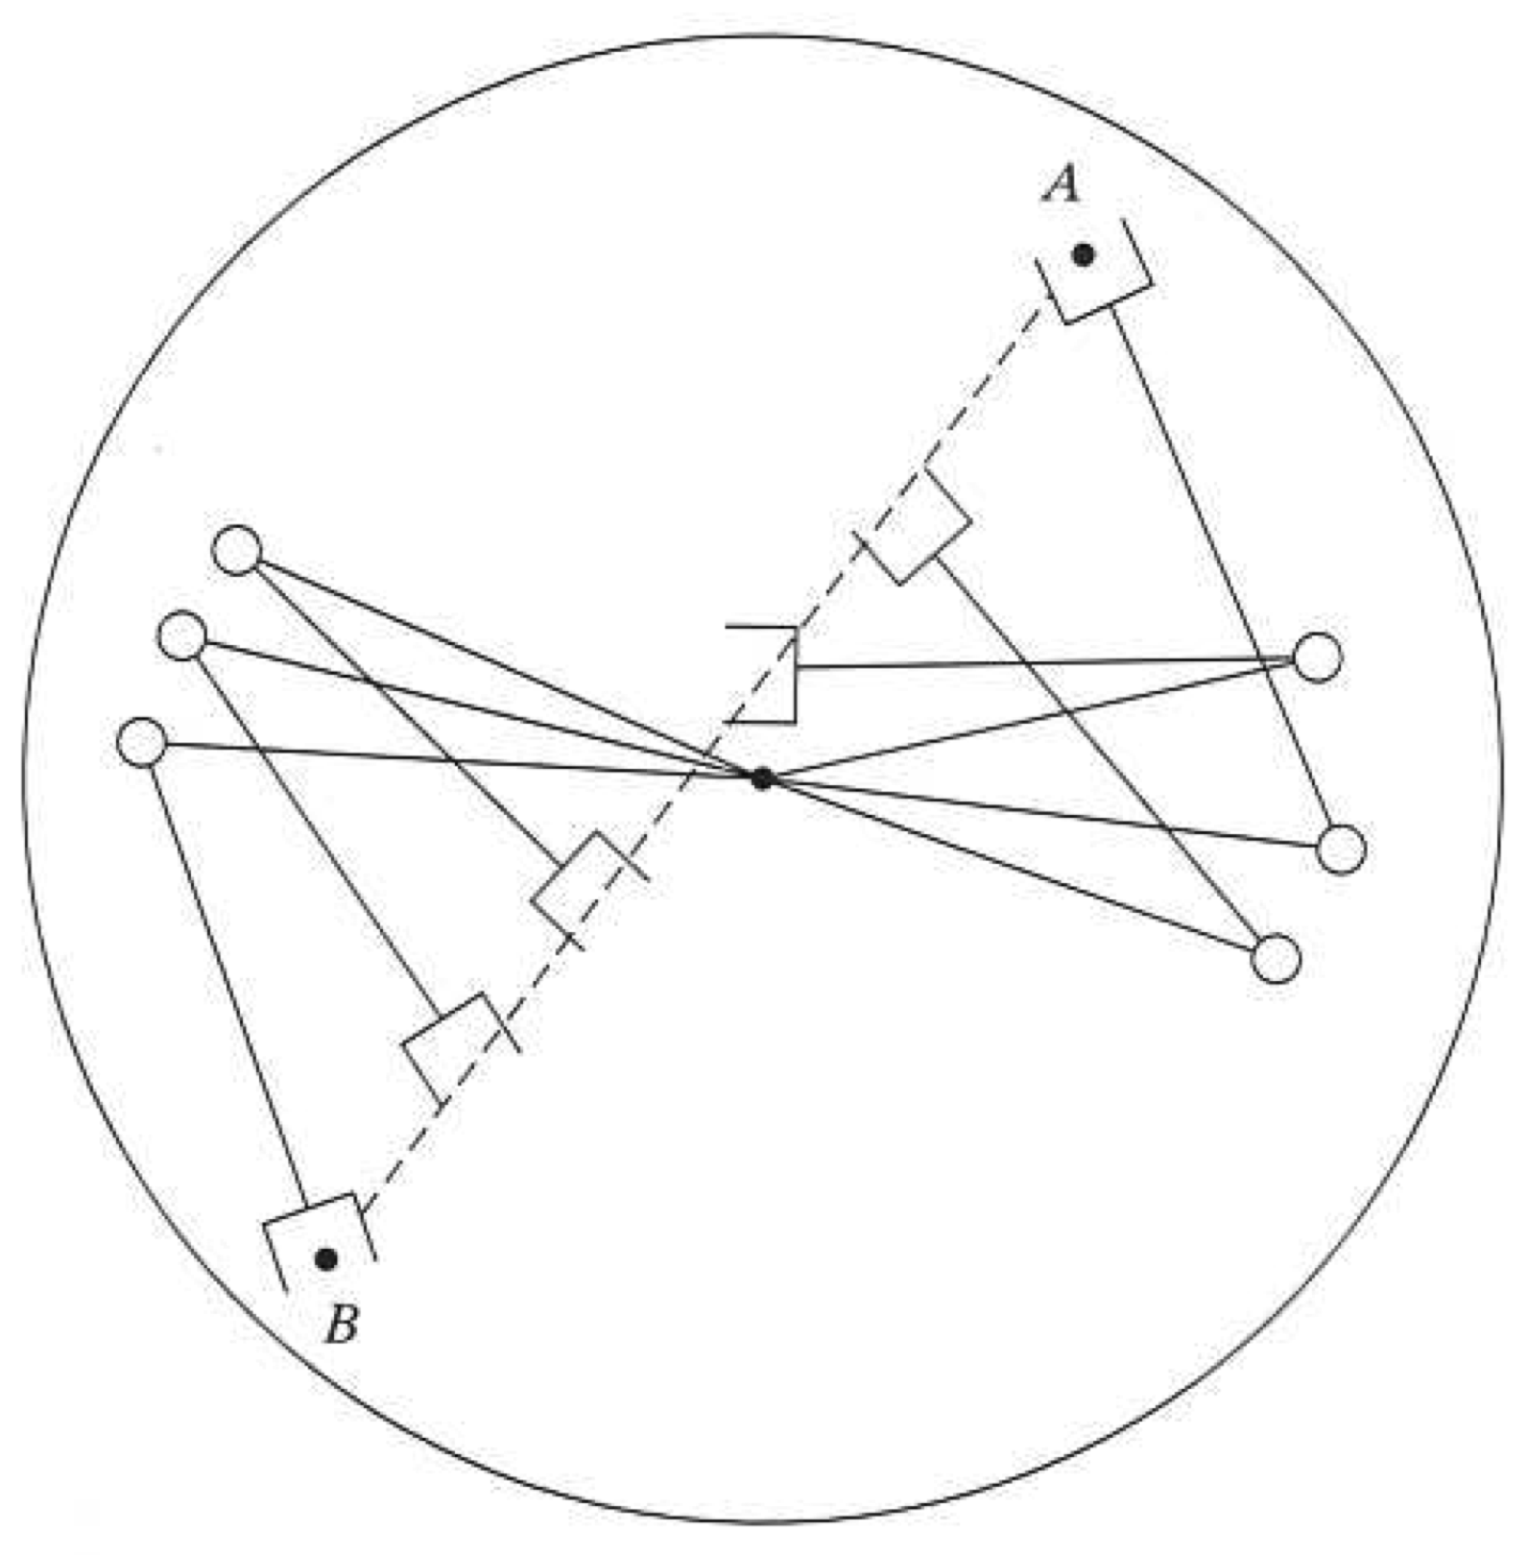
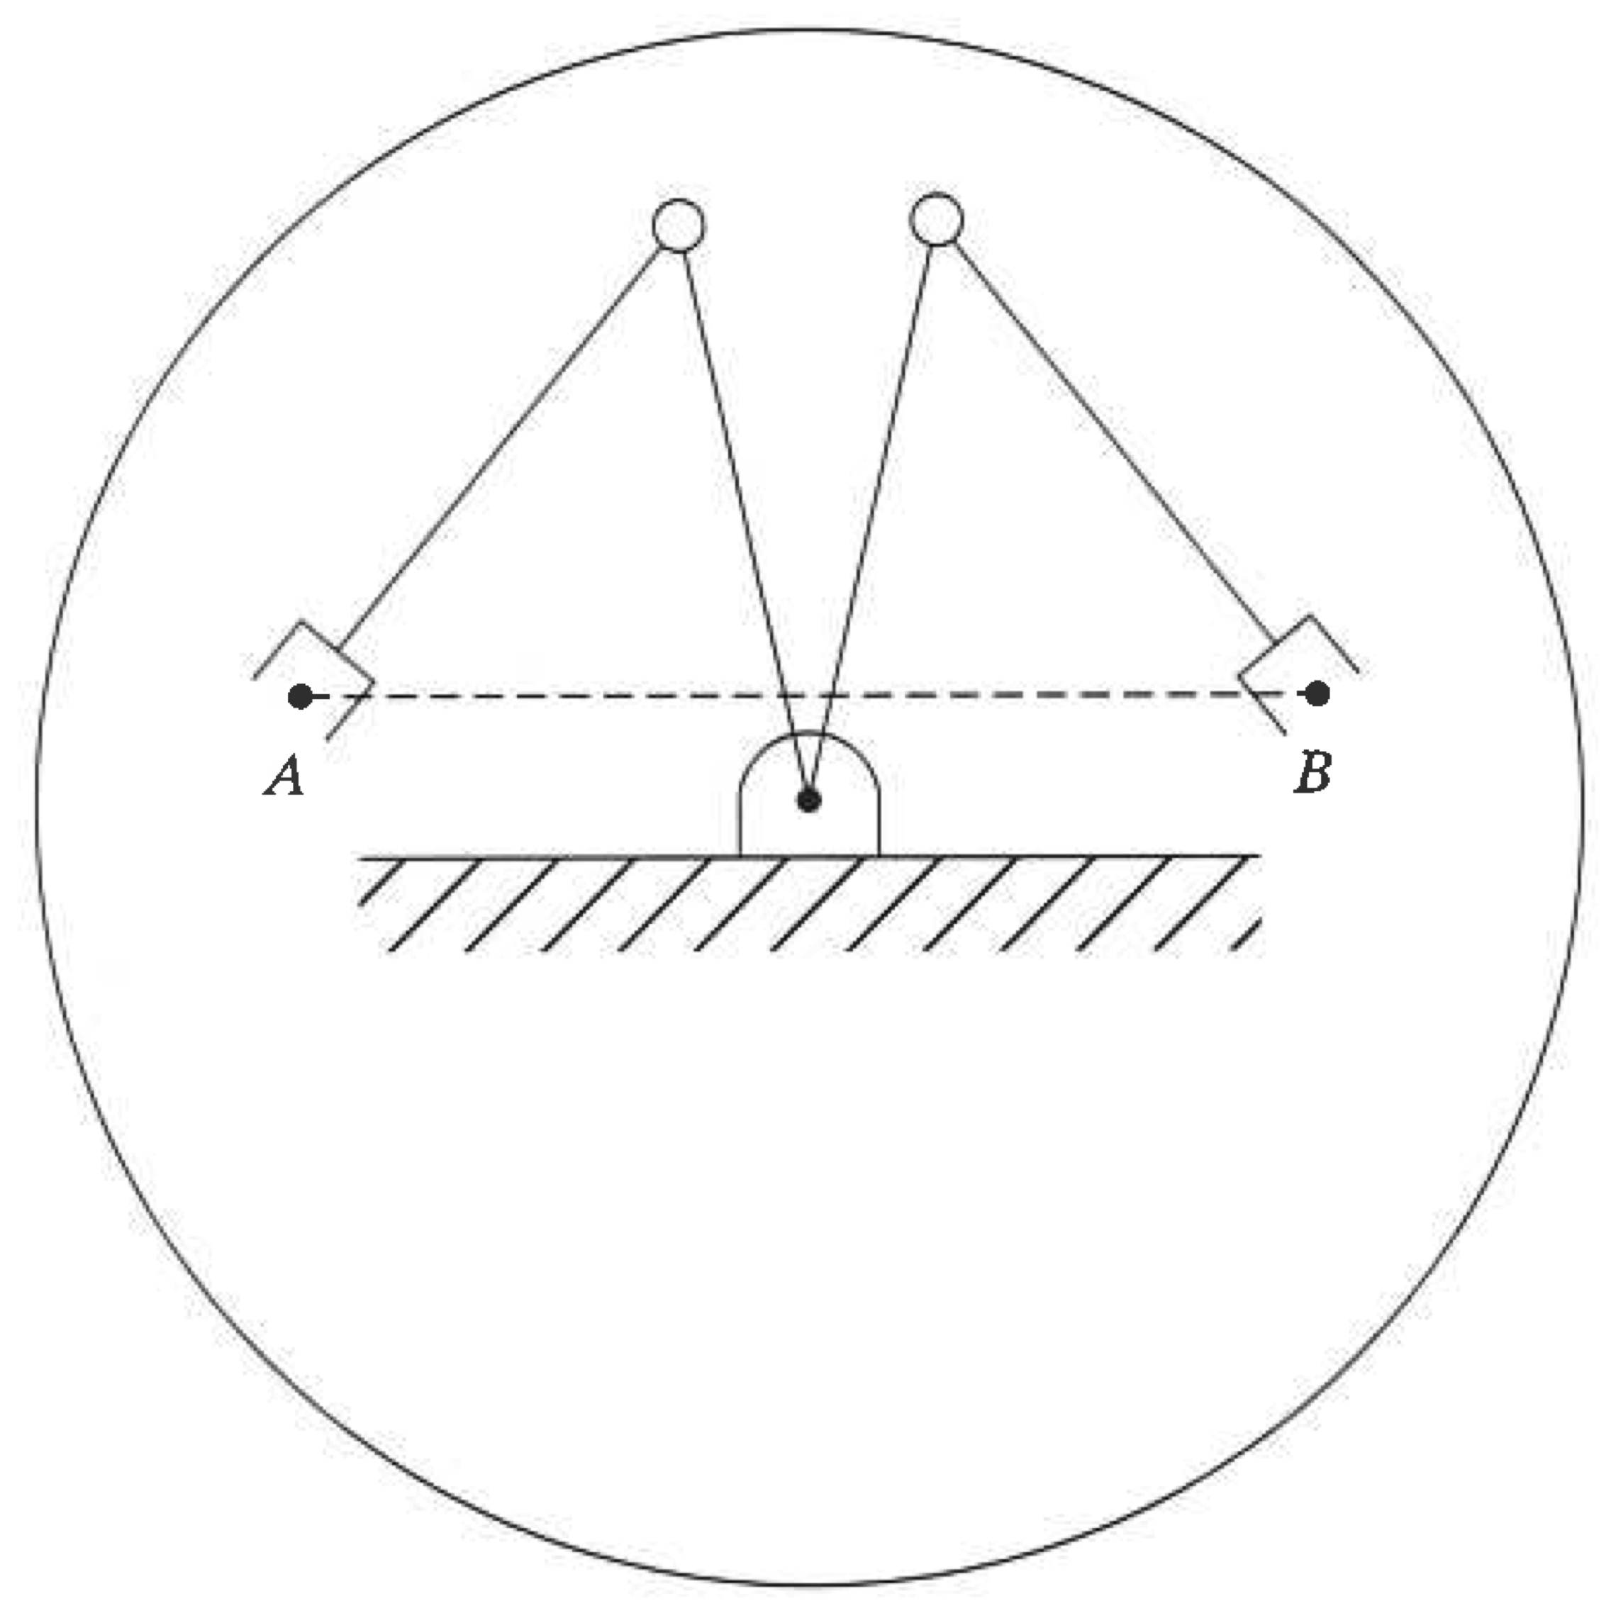
Cartesian Space Difficulties
Type A Type B Type C
Points not in workspace
Path through singularity
Different configuration

Slide 18
Cartesian Space -Trajectory Constraints
Spatial – obstacles
Temporal – timing issues
Smoothness – avoiding jerky movements

Slide 19
Cartesian Space -Trajectory Generation
Goal:
Turn a specified Cartesian space trajectory of P_{e} into appropriate joint position reference values
Steps:
Use inverse kinematics of a robot manipulator arm to find joint values for any particular location of P_{e}
Use sampling and curve fitting to reduce computation
Output:
A series of joint position/velocity reference values to send to the controller
Notes:
19

Slide 20
Cartesian Space -Trajectory Generation (2)
Step | Mode
Obtain function for path | C
Sample function to get discrete joint points | D
Apply IK & Jacobian calculations | D
Fit function to joint points | C
Sample to get discrete reference points | D
C=continuous D=discrete
Notes:
20

Slide 21
Example : Linear Motion
Express line as continuous function (i.e. parameterise by time):
x(t), y(t)
Suppose we specify the line y= mx +b
Want to move along line with constant speed, u
Notes:
21

Slide 22
Example : Linear Motion
Parameterise the line
Equation of line
Differentiate
Planar Velocity vector
Substitute
Notes:
22

Slide 23
Example : Linear Motion
Parameterise the line (2)
Velocity (magnitude)
Notes:
23

Slide 24
Example : Linear Motion
Parameterise the line (2)
Velocity (magnitude)
Solve for the x element (pick appropriate sign)
Notes:
24

Slide 25
Example : Linear Motion
Parameterise the line (3)
And by substituting and then integrate we get:
Notes:
25

Slide 26
Example : Linear Motion
Sample the continuous Path Function
Use M samples of the total time t_{total}
Notes:
26

Slide 27
Trajectory Generation Numerical Example : Linear Motion
Let’s take a 2-link planar arm with
Link lengths: l₁ = 4, l₂ = 3 m
Start point = (0, l₁ + l₂ /4)=(0,4.75)
End point = (l₁ + l₂ /4,0)=(4.75,0)
Constant speed u=3 m/s
Note, in practice, speed usually follows a trapezoidal profile with acceleration/deceleration at start/end of the motion
Notes:
27

Slide 28
Numerical Example : Linear Motion
Step 1 – Establish the function for path
The path has the equation:
And a length of:
Which for a constant speed will take:
Notes:
28

Slide 29
Numerical Example : Linear Motion
Step 2 – Sample the Function
We will use M=9 sample points
And for constant speed we will have
Notes:
29

Slide 30
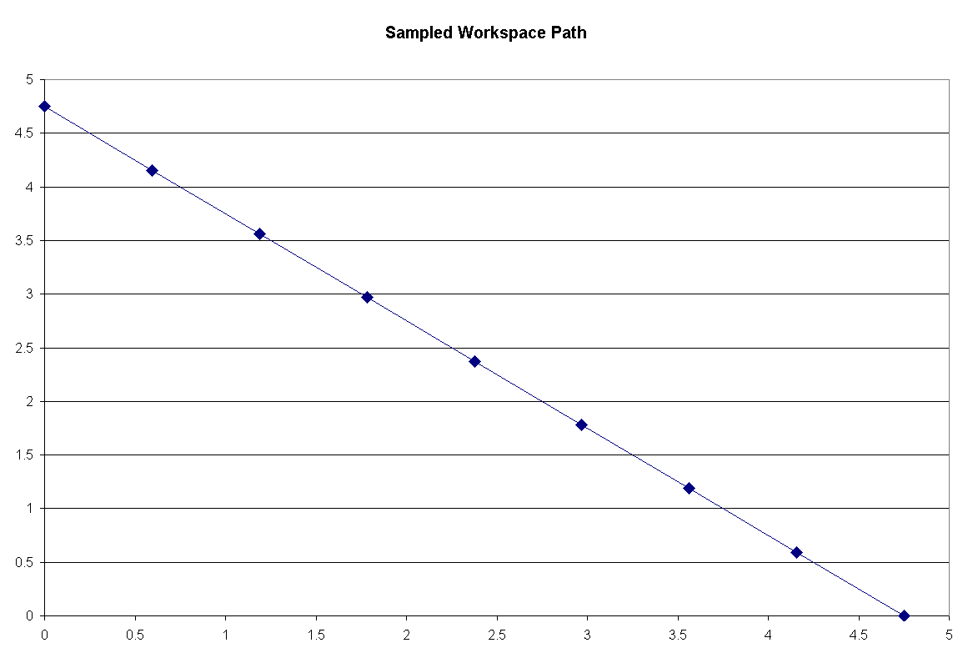
Numerical Example : Linear Motion
Step 2 – Sample the Function
y (m)
x (m)
Notes:
30

Slide 31
Numerical Example : Linear Motion
Step 3 – IK on the Sampled points
Position Inverse Kinematics:
where
Notes:
31

Slide 32
Numerical Example : Linear Motion
Step 3 – IK on the Sampled points
Velocity Inverse Kinematics:
where
Notes:
32

Slide 33
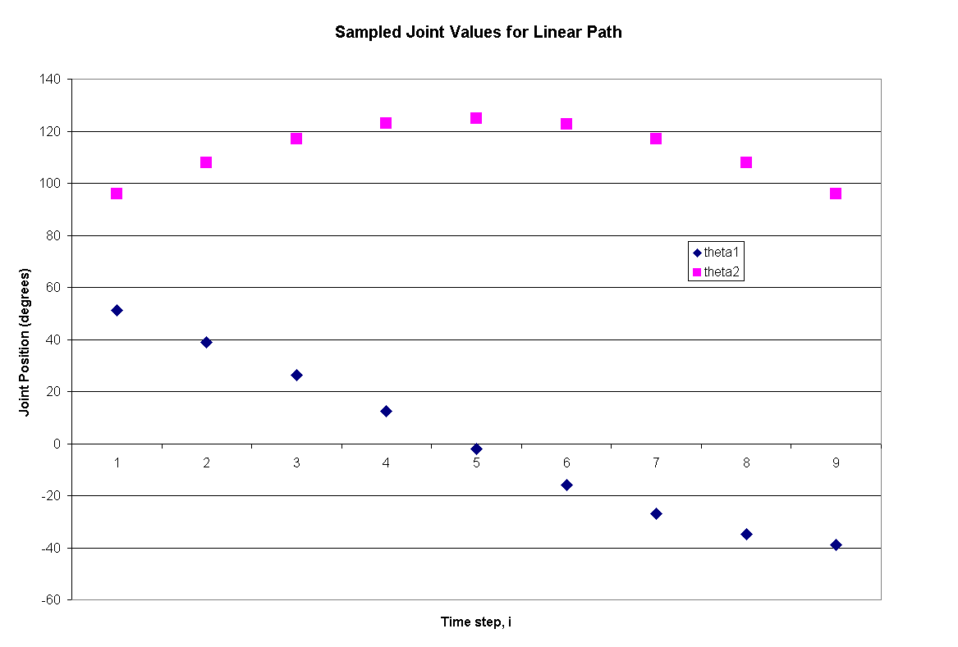
Numerical Example : Linear Motion
Step 3 – Joint Position Values from IK
Notes:
33

Slide 34
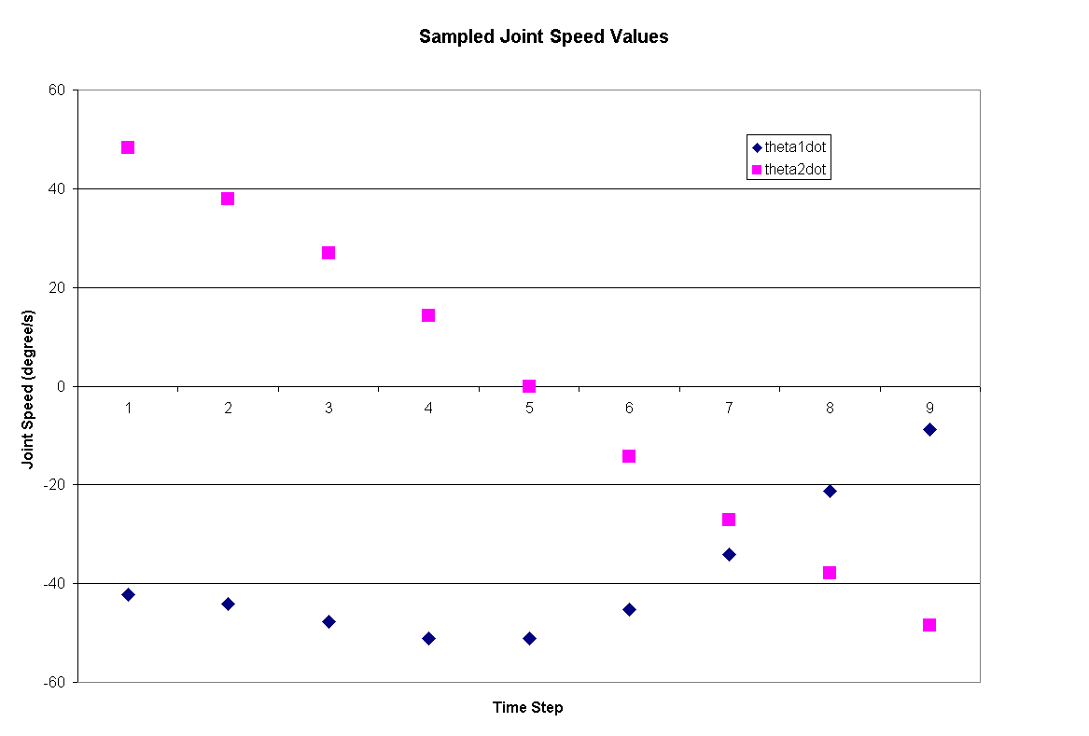
Numerical Example : Linear Motion
Step 3 – Joint Position Values from IK
Notes:
34

Slide 35
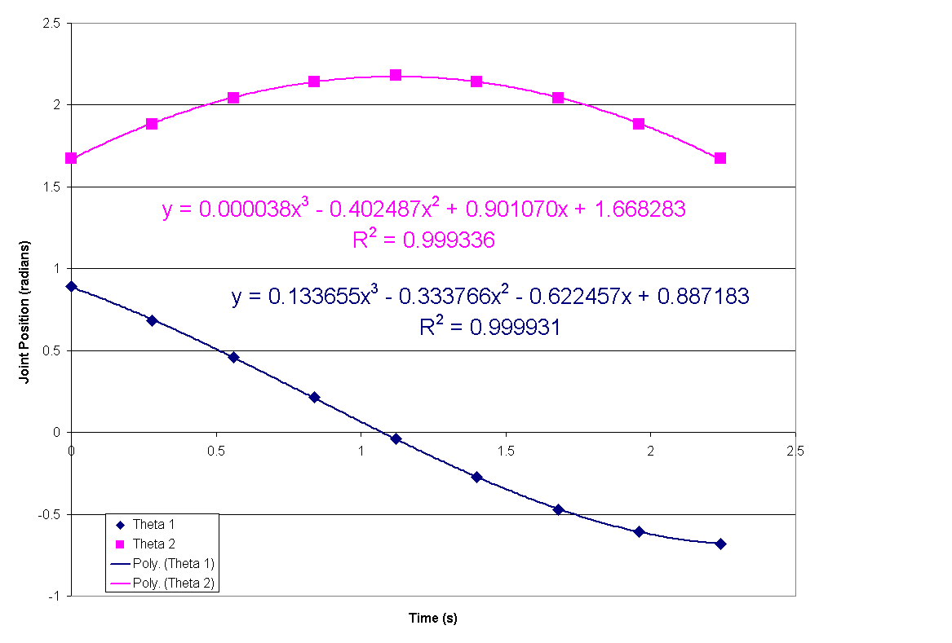
Numerical Example : Linear Motion
Step 4 – Fit Cubic to Position/Velocity
Notes:
35

Slide 36
Numerical Example : Linear Motion
Curve Fitting Comments (Step 4)
Typically, a single cubic is not sufficient for the entire motion
A quintic polynomial can fit position, velocity and accelerations of end-points
Notes:
36

Slide 37
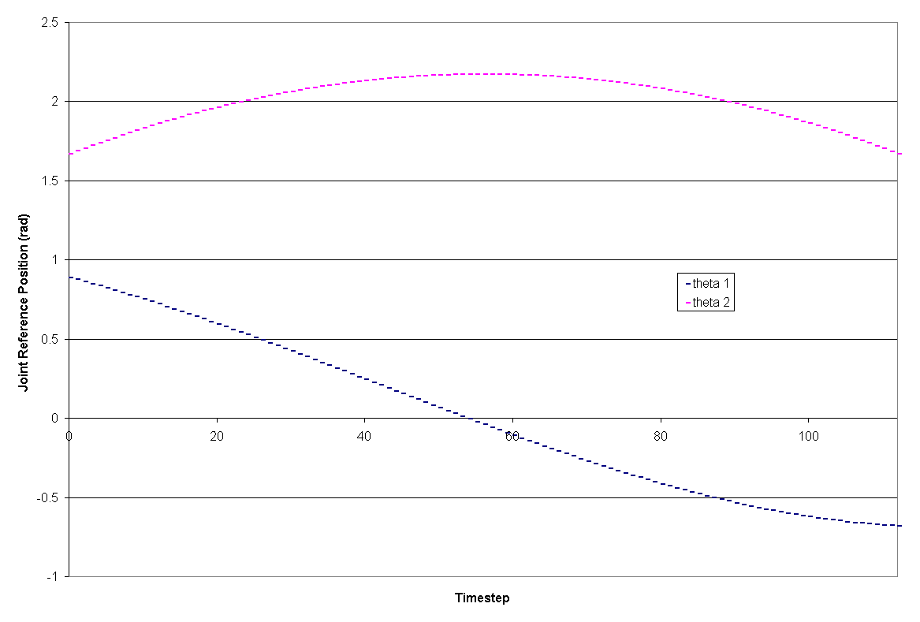
Numerical Example : Linear Motion
Step 5 – Sample Equation to get points
Sample at 0.02s
Notes:
37

Slide 38
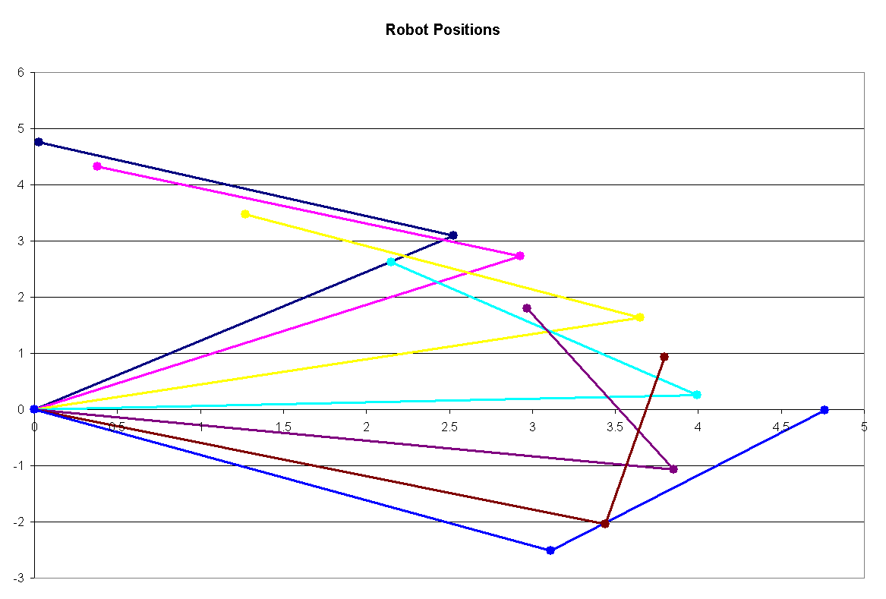
Numerical Example : Linear Motion
Trajectory Followed
y (m)
x (m)
Notes:
38

Slide 39
Run time path generation
Joint-space paths
Coefficients fed to the control system at the end of each segment (high order poly) or checked if in linear or blend portion (linear with blends)
Cartesian space paths
Use the linear with blends path generator but use x, y instead of the joint angles in the equations. These are then converted in the joint angles using IK.

Slide 40
Collision-free path planning
Local vs global motion planning
Gross motion planning for uncluttered areas
Fine motion planning for the end effector frame
Configurations space approach
Artificial potential field approach

Slide 41
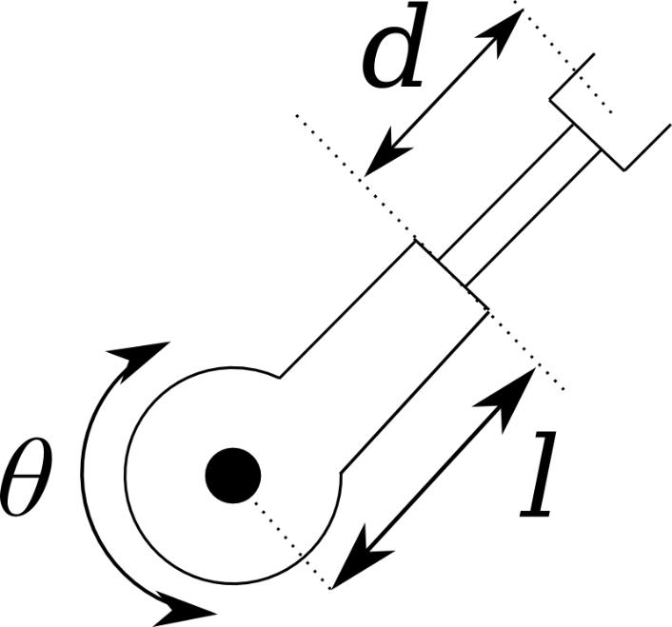
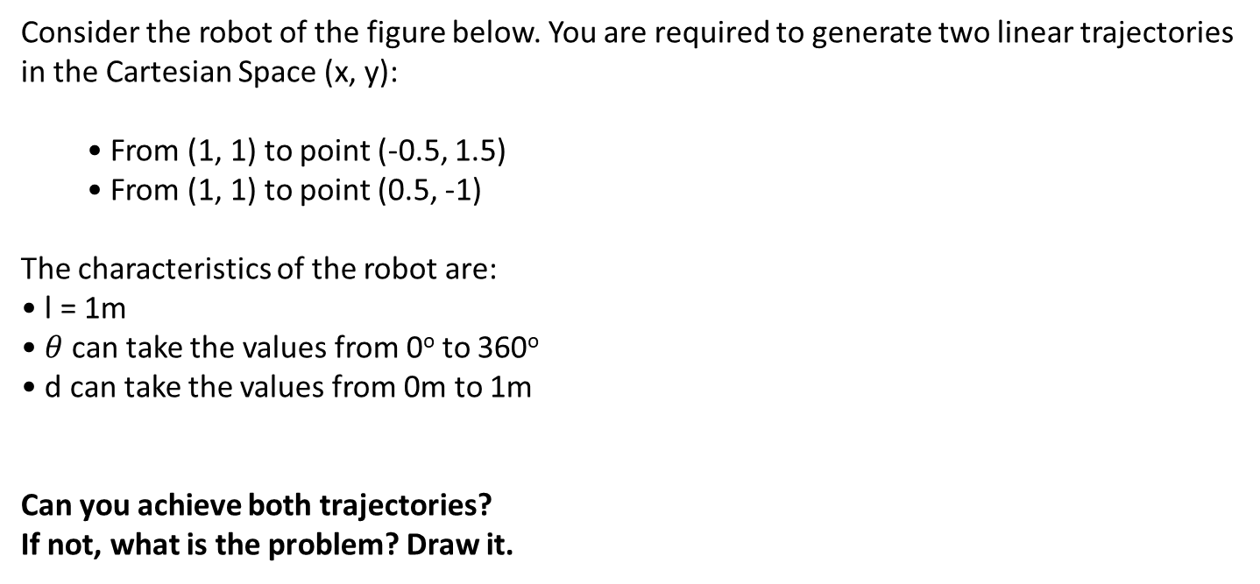
Example
Consider the robot of the figure below. You are required to generate two linear trajectories in the Cartesian Space (x, y):
• From (1, 1) to point (-0.5, 1.5)
• From (1, 1) to point (0.5, -1)
The characteristics of the robot are:
• l = 1m
• $θ$can take the values from 0º to 360º
• d can take the values from 0m to 1m
Can you achieve both trajectories?
If not, what is the problem? Draw it.

Slide 42
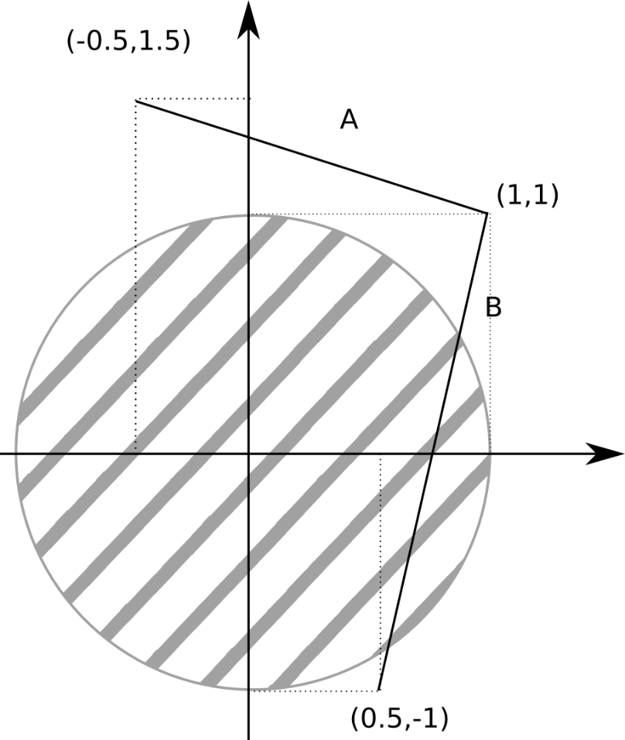
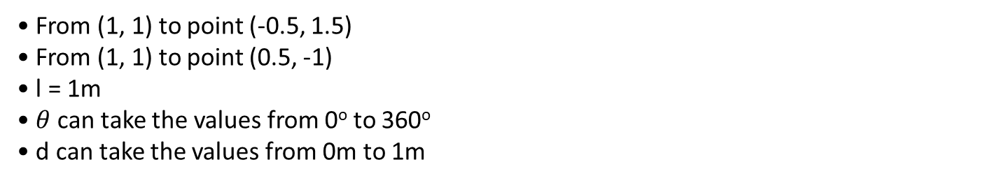
Example
• From (1, 1) to point (-0.5, 1.5)
• From (1, 1) to point (0.5, -1)
• l = 1m
• $θ$can take the values from 0º to 360º
• d can take the values from 0m to 1m

Slide 43
Conclusions
Via points have different calculations for different parts of the trajectory
Linear motion achieved only in Cartesian Space
Cartesian Space might lead manipulator to singular configurations
Cartesian Space calculations are happening in discrete and continuous methods

Slide 44
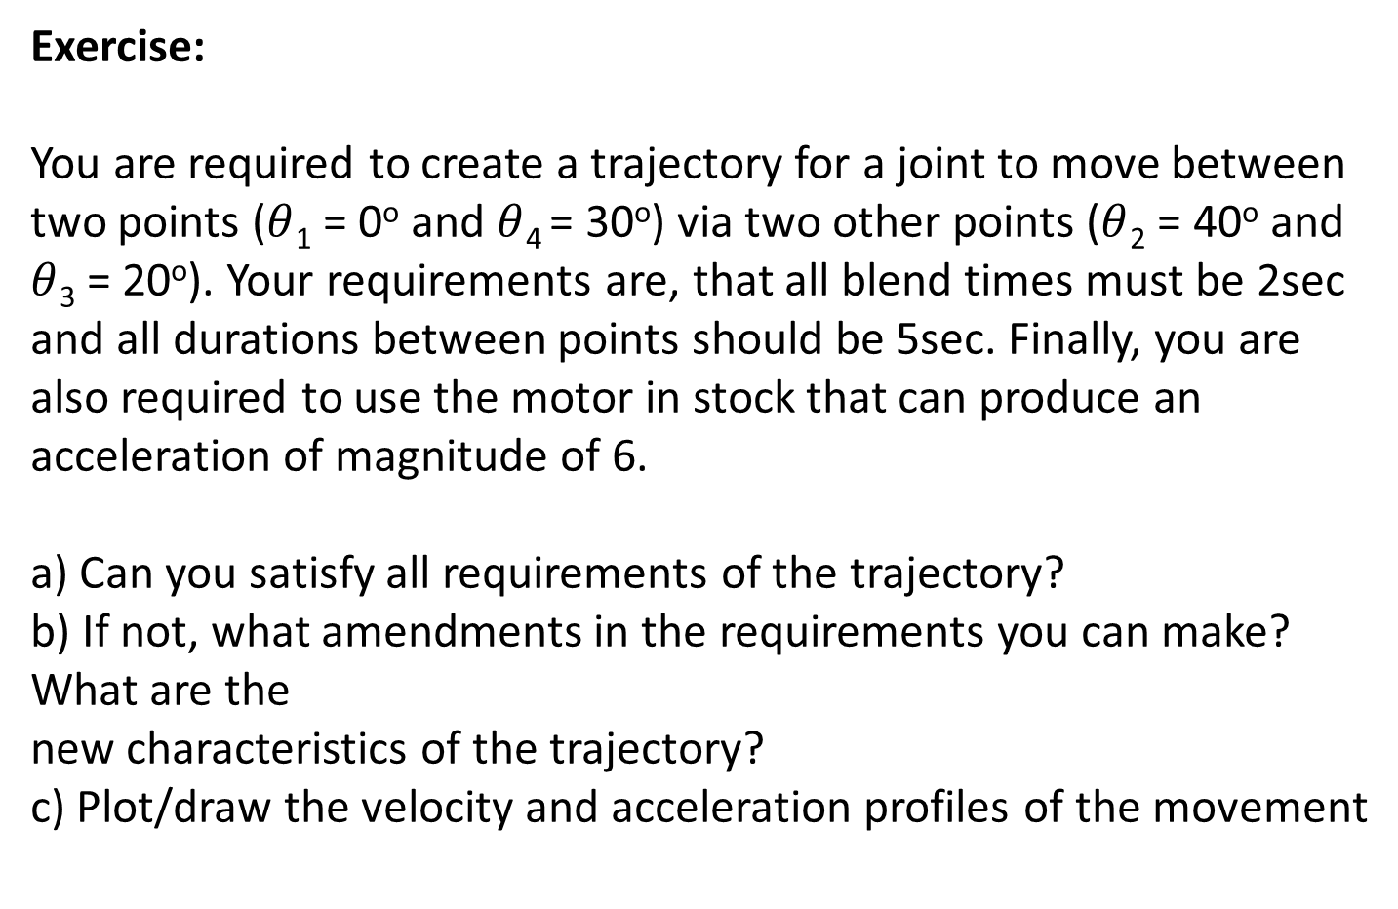
Exercise:
You are required to create a trajectory for a joint to move between two points ($θ$₁ = 0º and $θ$₄ = 30º) via two other points ($θ$₂ = 40º and $θ$₃ = 20º). Your requirements are, that all blend times must be 2sec and all durations between points should be 5sec. Finally, you are also required to use the motor in stock that can produce an acceleration of magnitude of 6.
a) Can you satisfy all requirements of the trajectory?
b) If not, what amendments in the requirements you can make? What are the
new characteristics of the trajectory?
c) Plot/draw the velocity and acceleration profiles of the movement

